Slide 1
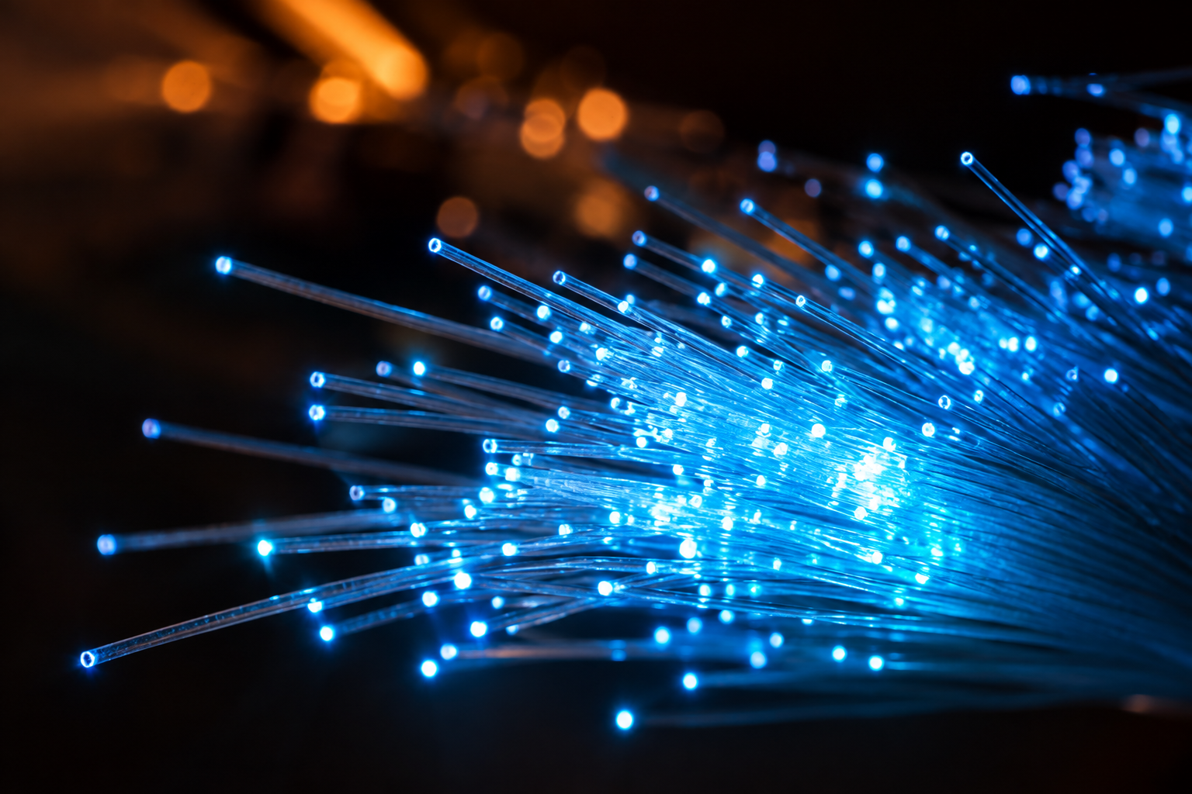
Intelligent Ethernet-to-Fiber
Media Converter
with Proactive Fault Detection and Redundant Failover
TEAM
Madhawi Alharbi · Ethan Su · Auska Wang · Yichi Zhang
Dr. Jane Gu | Georgia Tech ECE Capstone | September 23, 2026
PROPOSAL
Notes:
Source: ECE Proposal Report supplied by the PHOTON team.

Slide 2
Motivation
02
AI data centers require higher bandwidth and longer transmission distances.
Optical fiber offers low loss and immunity to electromagnetic interference.
Fiber links may degrade because of contamination, bending, temperature, or aging.
Conventional media converters typically respond only after link failure (passive).
Earlier detection could reduce packet loss and service interruption.
LINK CONDITION
Healthy
WARNING REGION
Degrading
CONVENTIONAL RESPONSE
Link failure
Notes:
Source: ECE Proposal Report supplied by the PHOTON team.

Slide 3
Proposed Solution
03
MONITOR
DETECT
SWITCH
Continuously collect SFP diagnostics and status information.
Identify sustained optical degradation before loss of signal.
Coordinate both boards and transfer traffic to the backup path.
Two identical boards · Primary and backup 1000BASE-SX channels
Laboratory-scale proof of concept
Notes:
Source: ECE Proposal Report supplied by the PHOTON team.

Slide 4
System Architecture
04
BOARD A
PRIMARY 1000BASE-SX
BOARD B
LAN96455F
STM32N6
2 × SFP
LAN96455F
STM32N6
2 × SFP
LAPTOP A
LAPTOP B
1000BASE-T
1000BASE-T
BACKUP 1000BASE-SX
User traffic is forwarded by the Ethernet switch and does not pass through the STM32N6.
Notes:
Source: ECE Proposal Report supplied by the PHOTON team.

Slide 5
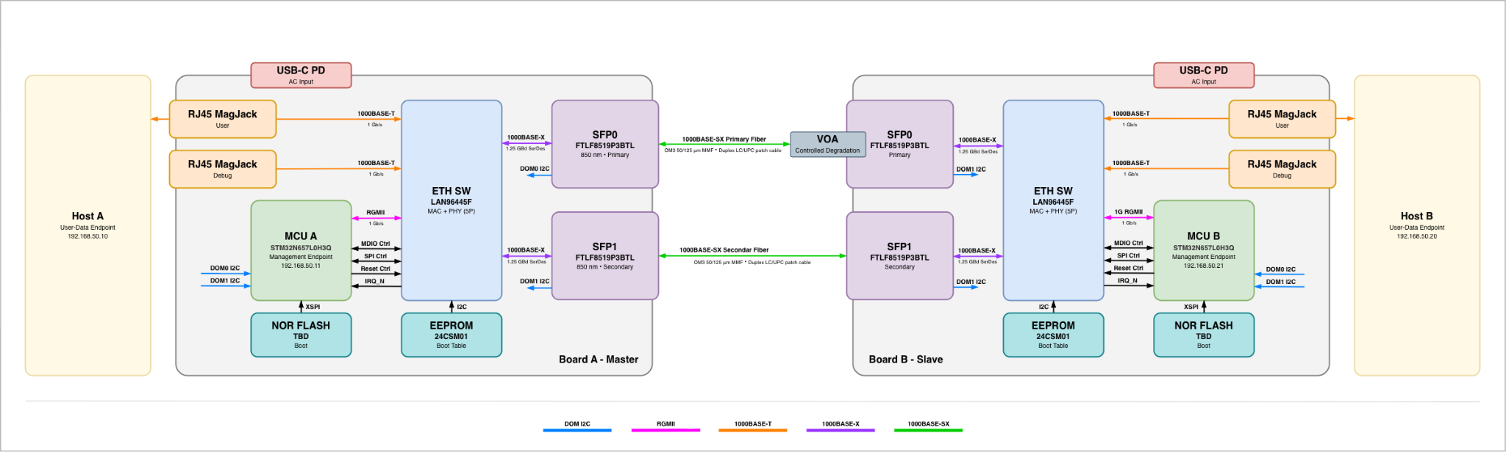
System Architecture
04
Notes:
Source: ECE Proposal Report supplied by the PHOTON team.

Slide 6
Hardware Design
05
Hardware:
LAN96455F
STM32N6
FTLF8519P3BNL
Ethernet switching
and path control
Monitoring, communication,
and failover management
1000BASE-SX
optical transceiver
Protocols:
I²C
SPI
RGMII
SFP diagnostic acquisition
Switch configuration and monitoring
Management Ethernet interface
Notes:
Source: ECE Proposal Report supplied by the PHOTON team.

Slide 7
Firmware Architecture
06
Event Logging and Serial Status
Coordinated Failover State Machine
Link-Health Assessment
Telemetry and Board-to-Board Communication
I²C · SPI · RGMII · GPIO Drivers
User traffic remains in dedicated switching hardware.
Notes:
Source: ECE Proposal Report supplied by the PHOTON team.

Slide 8
SFP Health Monitoring
07
OPTICAL
MODULE
STATUS
Received optical power
Transmitted optical power
Temperature
Supply voltage
Laser-bias current
Module presence
Loss of signal
Transmitter fault
Each record includes source, acquisition time, and validity.
≥ 1 Hz
2 ENDS
Complete local update
for both SFP modules
Channel health uses data
from both boards
Notes:
Source: ECE Proposal Report supplied by the PHOTON team.

Slide 9
Proactive Failover Logic
08
Monitor
Primary
Threshold
Crossed
Persistence
Confirmed
Backup
Healthy
Coordinate
Boards
Switch to
Backup
Threshold
Persistence
Hysteresis
Recovery follows a configurable failback policy and stability delay.
Notes:
Source: ECE Proposal Report supplied by the PHOTON team.

Slide 10
Key Technical Targets
09
1 GbE
≥ 900 Mb/s
≥ 1 update/s
< 100 ms*
1000BASE-T and
1000BASE-SX links
Sustained TCP
throughput
Local SFP
telemetry
Traffic interruption
stretch target
Failover before the primary receiver asserts loss of signal.
Matching active-path state after every acknowledged path change.
At least 20 path transitions and 20 consecutive power cycles.
* Preliminary stretch target; performance has not yet been experimentally verified.
Notes:
Source: ECE Proposal Report supplied by the PHOTON team.

Slide 11
Demonstration Plan
10
1
2
3
4
5
Generate continuous
bidirectional traffic
Increase primary-path
optical attenuation
Monitor SFP diagnostics
and path state
Transfer traffic to
the backup path
Measure network
performance
RECORDED RESULTS
Received optical power · Active path · LOS · Throughput · Packet loss · Interruption time
Notes:
Source: ECE Proposal Report supplied by the PHOTON team.

Slide 12
Key Risks and Mitigation
11
RISK
MITIGATION
Limited switch evaluation hardware
Early documentation and register study
First-spin PCB failure
Test points and staged bring-up
In-band communication loss
Early warning and bounded timeouts
Hardware delays
Simulated telemetry for firmware testing
Slow failover
Measure and optimize each source of delay
Notes:
Source: ECE Proposal Report supplied by the PHOTON team.

Slide 13
Schedule and Current Status
12
Requirements and architecture
COMPLETE
Component and interface selection
COMPLETE
Schematic design
IN PROGRESS
Firmware implementation
EARLY DEVELOPMENT
PCB fabrication, integration, and testing
UPCOMING
CAPSTONE EXPO · DECEMBER 8, 2026
Notes:
Source: ECE Proposal Report supplied by the PHOTON team.

Slide 14
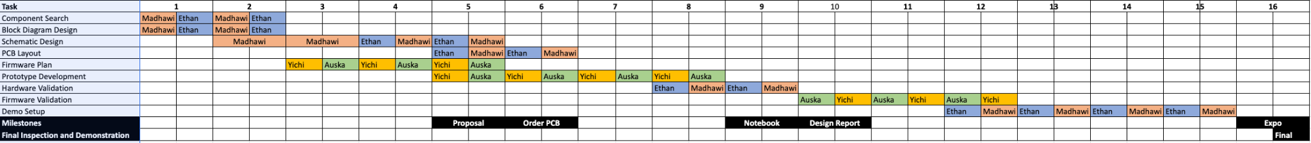
Schedule and Current Status
12
Notes:
Source: ECE Proposal Report supplied by the PHOTON team.

Slide 15
Team Responsibilities
13
MADHAWI
ETHAN
AUSKA
YICHI
Hardware design
PCB development
Ethernet switch hardware
Board bring-up
Firmware architecture
Switch configuration
STM32 firmware and SFP monitoring
Health monitoring and failover logic
System integration and bring-up are collaborative team activities.
Notes:
Source: ECE Proposal Report supplied by the PHOTON team.

Slide 16
Expected Outcome
14
Two identical Ethernet-to-fiber converter boards
Real-time SFP diagnostic monitoring
Primary and backup optical paths
Coordinated pre-failure failover
Measured throughput, packet loss, interruption, and recovery behavior
PROACTIVE
OPTICAL
FAULT
MANAGEMENT
before complete link failure
Notes:
Source: ECE Proposal Report supplied by the PHOTON team.

